Slide 1
Chapter 11: Trigonometric Identities
11.1 Trigonometric Identities
11.2 Addition and Subtraction Formulas
11.3 Double-Angle, Half-Angle, and Product-Sum Formulas
11.4 Inverse Trigonometric Functions
11.5 Trigonometric Equations

Slide 2
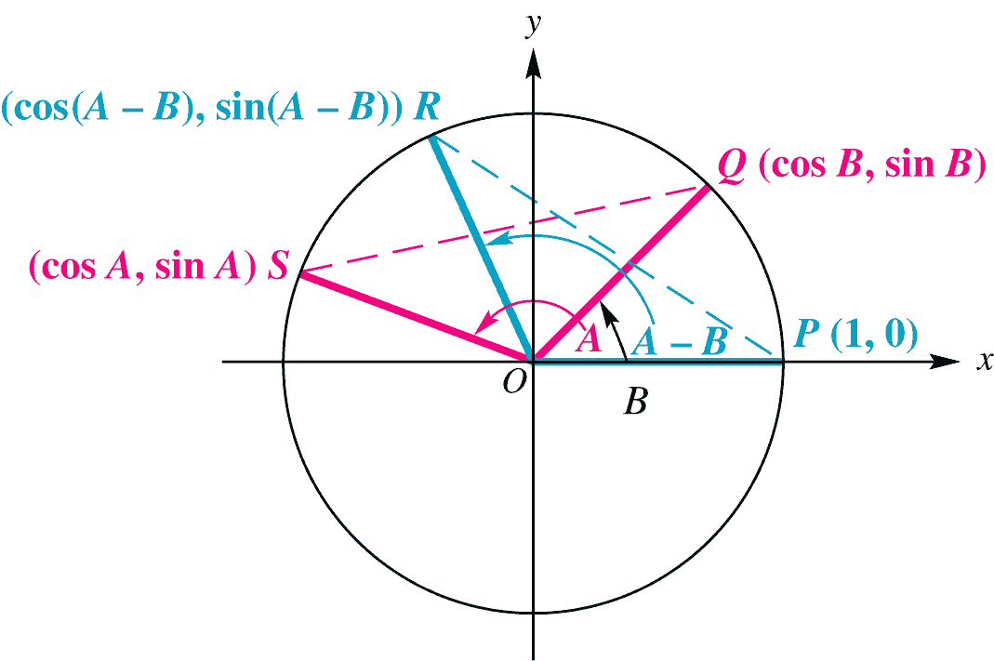
11.2 Sum and Difference Identities
Derive the identity for cos(A – B).
Let angles A and B be angles in standard position on a unit circle with B < A.
Let S and Q be the points on the terminal sides of angels A and B, respectively.
Q has coordinates (cos B, sin B).
S has coordinates (cos A, sin A).
R has coordinates (cos (A – B), sin (A – B)).
Angle SOQ equals A – B.
Since ∠SOQ = ∠POR, chords PR and SQ are equal.

Slide 3
11.2 Sum and Difference Identities
By the distance formula, chords PR = SQ,
Simplifying this equation and using the identity
sin² x + cos² x =1, we rewrote the equation as
cos(A – B) = cos A cos B + sin A sin B.

Slide 4
11.2 Sum and Difference Identities
To find cos(A + B), rewrite A + B as A – (– B) and use the identity for cos (A – B).
Cosine of a Sum Or Difference
cos(A – B) = cos A cos B + sin A sin B
cos(A + B) = cos A cos B – sin A sin B

Slide 5
11.2 Finding Exact Cosine Values
Example Find the exact value of the following.
cos 15°

Slide 6
11.2 Sine of a Sum or Difference
Using the cofunction relationship and letting θ = A + B, we can obtain the:
Sine of a Sum or Difference
sin(A + B) = sin A cos B + cos A sin B
sin(A – B) = sin A cos B – cos A sin B

Slide 7
11.2 Tangent of a Sum or Difference
Using the identities for sin(A + B), cos(A + B), and tan(–B) = –tan B, we can derive the identities for the tangent of a sum or difference.
Tangent of a Sum or Difference

Slide 8
11.2 Example Using Sine and Tangent Sum or Difference Formulas
Example Find the exact value of the following.
sin 75°
tan
sin 40° cos 160° – cos 40° sin 160°
Solution
(a)

Slide 9
11.2 Example Using Sine and Tangent Sum or Difference Formulas
(b)
(c) sin 40° cos 160° – cos 40° sin 160°
= sin(40° – 160°)
= sin(–120°)

Slide 10
11.2 Finding Function Values and the Quadrant of A + B
Example Suppose that A and B are angles in standard
position, with
Find each of the following.
sin(A + B) (b) tan (A + B) (c) the quadrant of A + B
Solution
(a)
Since cos A < 0 in Quadrant II.

Slide 11
11.2 Finding Function Values and the Quadrant of A + B
(b) Use the values of sine and cosine from part (a) to
get
(c) From the results of parts (a) and (b), we find that
sin(A + B) is positive and tan(A + B) is also positive. Therefore, A + B must be in quadrant I.

Slide 12
11.2 Applying the Cosine Difference Identity to Voltage
Example Common household electric current is called
alternating current because the current alternates direction
within the wire. The voltage V in a typical 115-volt outlet can be
expressed by the equation V = 163 sin ωt, where ω is the
angular velocity (in radians per second) of the rotating generator
at the electrical plant and t is time measured in seconds.
It is essential for electric generators to rotate at 60 cycles per second so household appliances and computers will function properly. Determine ω for these electric generators.
Graph V on the interval 0 ≤ t ≤ .05.
For what value of φ will the graph of V = 163cos(ωt – φ) be the same as the graph of V = 163 sin ωt?

Slide 13
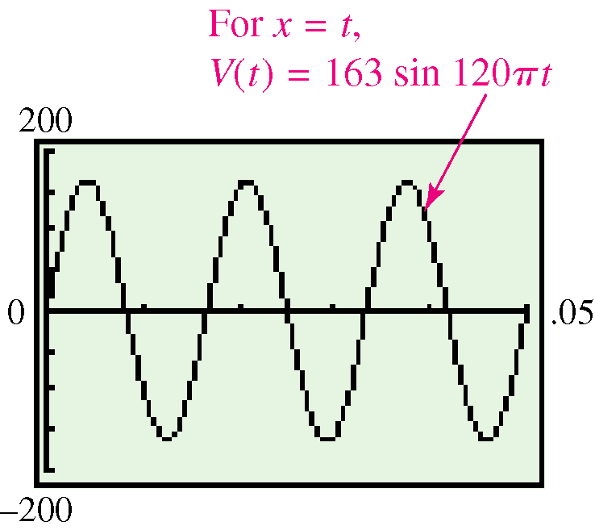
11.2 Applying the Cosine Difference Identity to Voltage
Solution
Since each cycle is 2π radians, at 60 cycles per second,
ω = 60(2π) = 120π radians per second.
(b) V = 163 sin ωt = 163 sin 120πt.
Because amplitude is 163,
choose –200 ≤ V ≤ 200 for the
range.
(c)

